Slide 1



THE BUSINESS CASE FOR
Women's Health Literacy
Why menopause education belongs at the center of medical training — not at its margins.
Adapted from the white paper by Lara Zibners, MD MMEd MBA & N. Adam Brown, MD MBA
| June 2026
Notes:
1

Slide 2

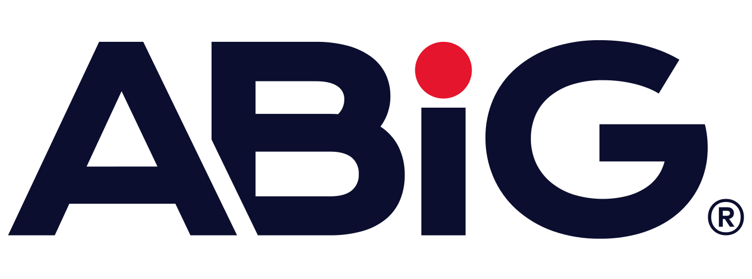

EXECUTIVE SUMMARY
A well-documented treatment gap — with an economic price tag
90M
women in the U.S. will be
postmenopausal by 2060
Healthcare systems treat men and women differently. It stems from systemic bias, under-representation of women in research, and a lack of women's-health training in medical school. Nowhere is this gap more costly than menopause: a universal transition for half the population that drives billions in healthcare spending and lost productivity every year — while physicians receive little to no foundational training in it.
58%
of medical textbooks worldwide
never mention menopause
$25B+
in direct annual U.S. medical
spend on menopause symptoms alone
This deck makes the case that early, universal menopause education for medical students reduces healthcare costs, strengthens economic output, and closes the gender treatment gap.
2
Notes:
2

Slide 3
1.0 CURRENT STATE OF AFFAIRS
Medical schools aren't teaching menopause
58%
of medical textbooks worldwide never mention menopause
31.3%
of OBGYN program directors report having a menopause curriculum
6.8%
of physicians in family medicine, internal medicine & OBGYN feel prepared to treat menopause after residency
20.3%
of residents received no lectures on menopause at all during training
Even though 92.9% of program directors agree residents nationwide should have access to a standardized menopause curriculum.
3
Notes:
5

Slide 4
1.2 WHAT'S AT RISK
A Cautionary Tale: The 2002 WHI Study
When physicians aren't trained to critically evaluate evidence, myths take hold — and patients pay the price for decades.
2002
Fallout
Result
Women's Health Initiative trial halted early on preliminary, later-found-flawed data linking hormone therapy to breast cancer risk.
Media reaction was swift; physicians abandoned hormone therapy en masse. Black-box warnings appeared even on treatments known to be safe.
Use dropped from ~27% to under 5% of menopausal women — a misunderstanding that persisted for two decades.
This single misinterpreted study may have contributed to thousands of premature deaths in menopausal women — underscoring why evidence-based education is an economic and moral imperative.
4
Notes:
6

Slide 5

2.0 SYSTEMIC IMPACT
Menopause touches every organ system —not just OBGYN
Heart & Stroke
Brain & Cognition
Bone Health
CVD accounts for 35% of deaths in women; stroke risk doubles in the 10 years after menopause onset.
Two-thirds of Alzheimer's patients are women; surgically induced menopause raises dementia risk.
80% of osteoporosis diagnoses are in women; 70% of hip-fracture hospitalizations occur in women.
Muscle & Frailty
Genitourinary (GSM)
Metabolic & Immune
Estrogen loss drives sarcopenia and age-related frailty, raising long-term care burden.
Affects over half of menopausal women; a major driver of recurrent UTIs and urinary sepsis.
Menopause worsens insulin resistance and is linked to higher rates of autoimmune disease.
5
Notes:
7

Slide 6
2.2 ESTIMATED COST BURDEN
The dollars behind the diagnosis
$25B
$200B+
$5.1B
in direct annual U.S. medical spend on menopausal symptoms (ages 45–60)
projected annual U.S. cost of cardiovascular disease in post-menopausal women
in 2011 hospitalization costs from non-traumatic post-menopausal fractures
Fewer than 12% of patients with a non-traumatic fracture had a pre-fracture osteoporosis diagnosis — a missed opportunity for prevention that, with better education, could save Medicare billions annually through interventions like topical estrogen therapy.
Sources: Mayo Clinic; peer-reviewed cost-of-illness analyses cited in the CLCC × ABIG Health white paper (June 2026)
6
Notes:
8

Slide 7
3.0 FOR ACADEMIC INSTITUTIONS
A low-cost curriculum change, a high-value return
Cost of inaction
Cost of action
Return on investment
Reputational risk. Schools that train physicians for men's conditions but omit menopause send an implicit message — and risk falling behind peer institutions.
Modest. Menopause content can be interlaced into existing coursework rather than added as new class load, using frameworks like EMAS's 2022 curriculum recommendation.
Higher student competency scores, better patient outcomes, stronger rankings, and new funding opportunities — such as The Menopause Society's recent $5M digital-training award.
7
Notes:
9

Slide 8
4.0 FOR THE BROADER HEALTHCARE SYSTEM
Better-trained physicians, leaner spending
3–50×
$4,600+
cost reduction (total & inpatient, respectively) seen when postmenopausal women with vasomotor symptoms receive appropriate estrogen therapy vs. none.
in wasteful spending per patient, per year, from unnecessary specialty visits and testing when menopause isn't recognized early.
Expected gains, by specialty
✓
Primary care: Better triage, fewer unnecessary referrals
✓
OBGYN: Streamlined, standardized care protocols
✓
Endocrinology / geriatrics: Reduced fragmentation of care
✓
Orthopedics: Fewer osteoporotic fractures & repair complications
8
Notes:
10

Slide 9
5.0 MACROECONOMICS & WORKFORCE
The workforce can't afford this gap
30%
of the U.S. labor force is women navigating the menopause transition — often at the height of their careers
1 in 3
women, many in senior roles, consider leaving or have left the workforce due to menopause symptoms
$5.4B
$120B
estimated impact of menopause-related disease burden on global GDP — among the top two women's health conditions economically
total cost including lost productivity and career-opportunity costs (missed promotions, early retirement)
9
Notes:
11

Slide 10
6.0 MOMENTUM IS BUILDING
Who's already leading the way
Academic medicine
Employers
Mayo Clinic, NYU Langone Health, UCLA, and Johns Hopkins have launched multi-disciplinary women's & menopause health centers.
EMAS
released a 2022 position statement calling for a standardized menopause curriculum for all healthcare providers worldwide — though adoption at the undergraduate level remains limited.
500+ companies — including Amazon, Microsoft, and Morgan Stanley — now offer menopause-related benefits through providers like Maven, Midi, and Carrot Fertility.
The business case for supporting employees through menopause is already proven in the private sector.
10
Notes:
12

Slide 11
7.0 CONCLUSION
A high-value, no-risk investment
Incorporating menopause-specific education across the medical school curriculum is a low-cost, high-impact intervention. It is not only a moral imperative — it is an economic one.
Reduced healthcare expenditures
More efficient, higher-quality patient care
A stronger, more resilient workforce
New research & funding opportunities
Call to action
Medical education institutions, physicians, business leaders, investors, researchers, and educators must work together to build a curriculum that can be developed quickly — with standardized learning, assessment, and outcome measurement.
11
Notes:
13

Slide 12
Thank you
Let's close the gender treatment gap — starting with how we train the next generation of physicians.
www.callali.ly | www.abighealth.com
Notes:
14

